Slide 1

WARRINGTON
& VALE ROYAL
COLLEGE
Erin Story
School Engagement Team

Slide 2


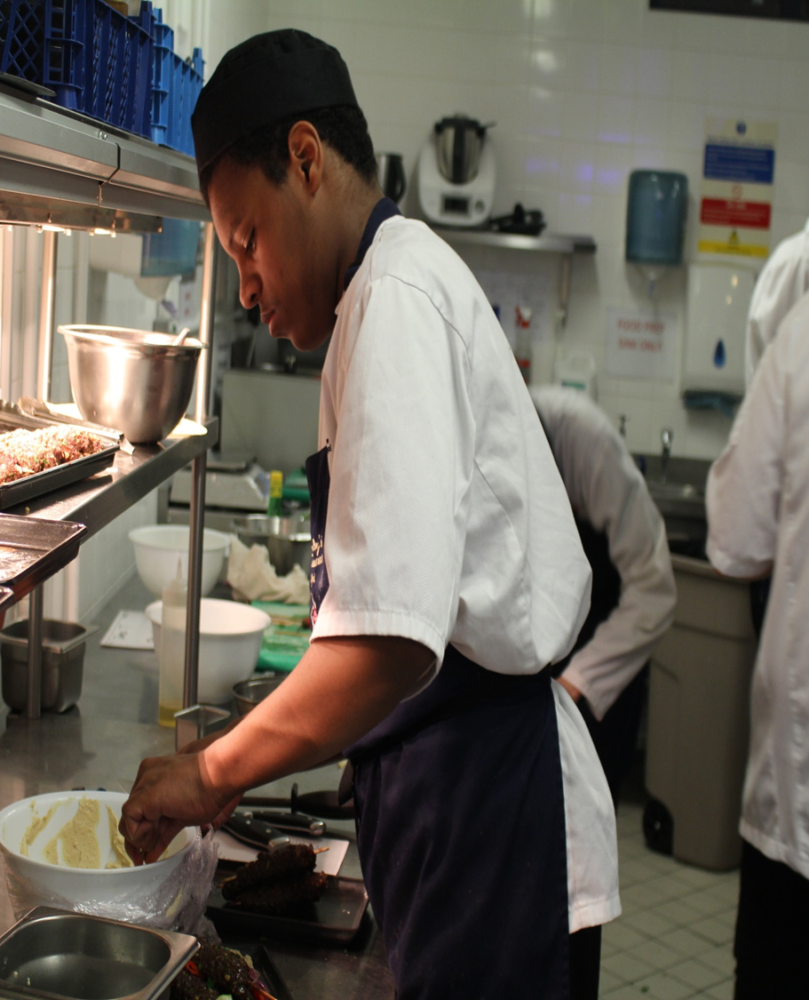
Careers/Course Advice
Think about your strongest school subjects- play to your strengths!
If you know what you would like to do as a future career, choose something that will help you get there!
Not sure? No problem! Choose something you love doing! It’s important to enjoy your subjects and future career.
This is your life. Try not to follow your friends, remember
to make your own decisions.

Slide 3
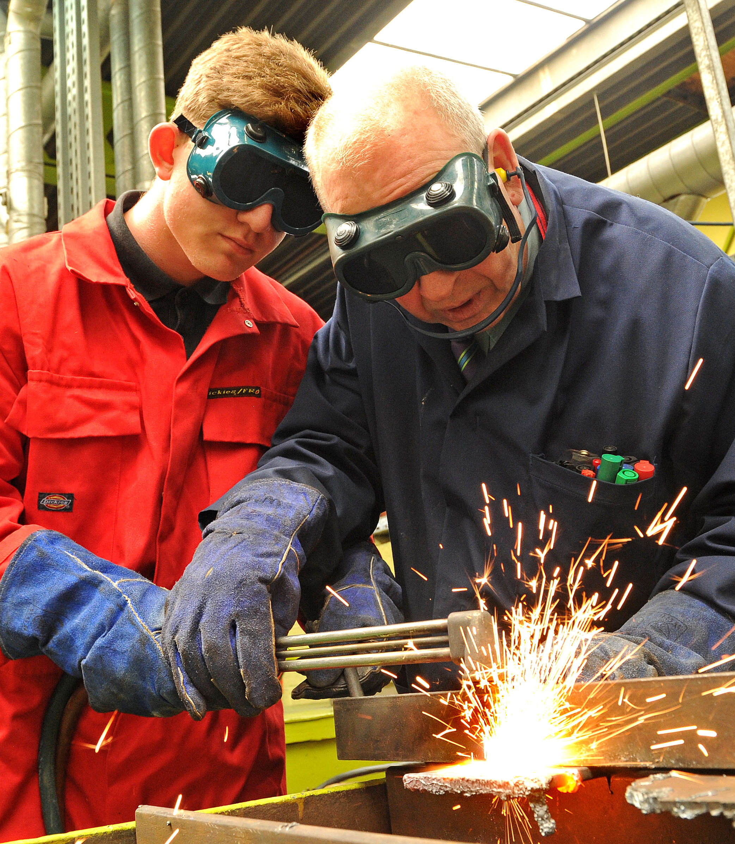
BEST CAREER
ROUTE FOR ME?
VOCATIONAL
Vocational courses are a great way of gaining a qualification if you prefer a practical, hands-on approach to learning.
APPRENTICESHIPS
Apprenticeships allow you to work and study at the same time. You will combine practical training in your workplace with studying at college - earning whilst you learn.

Slide 4

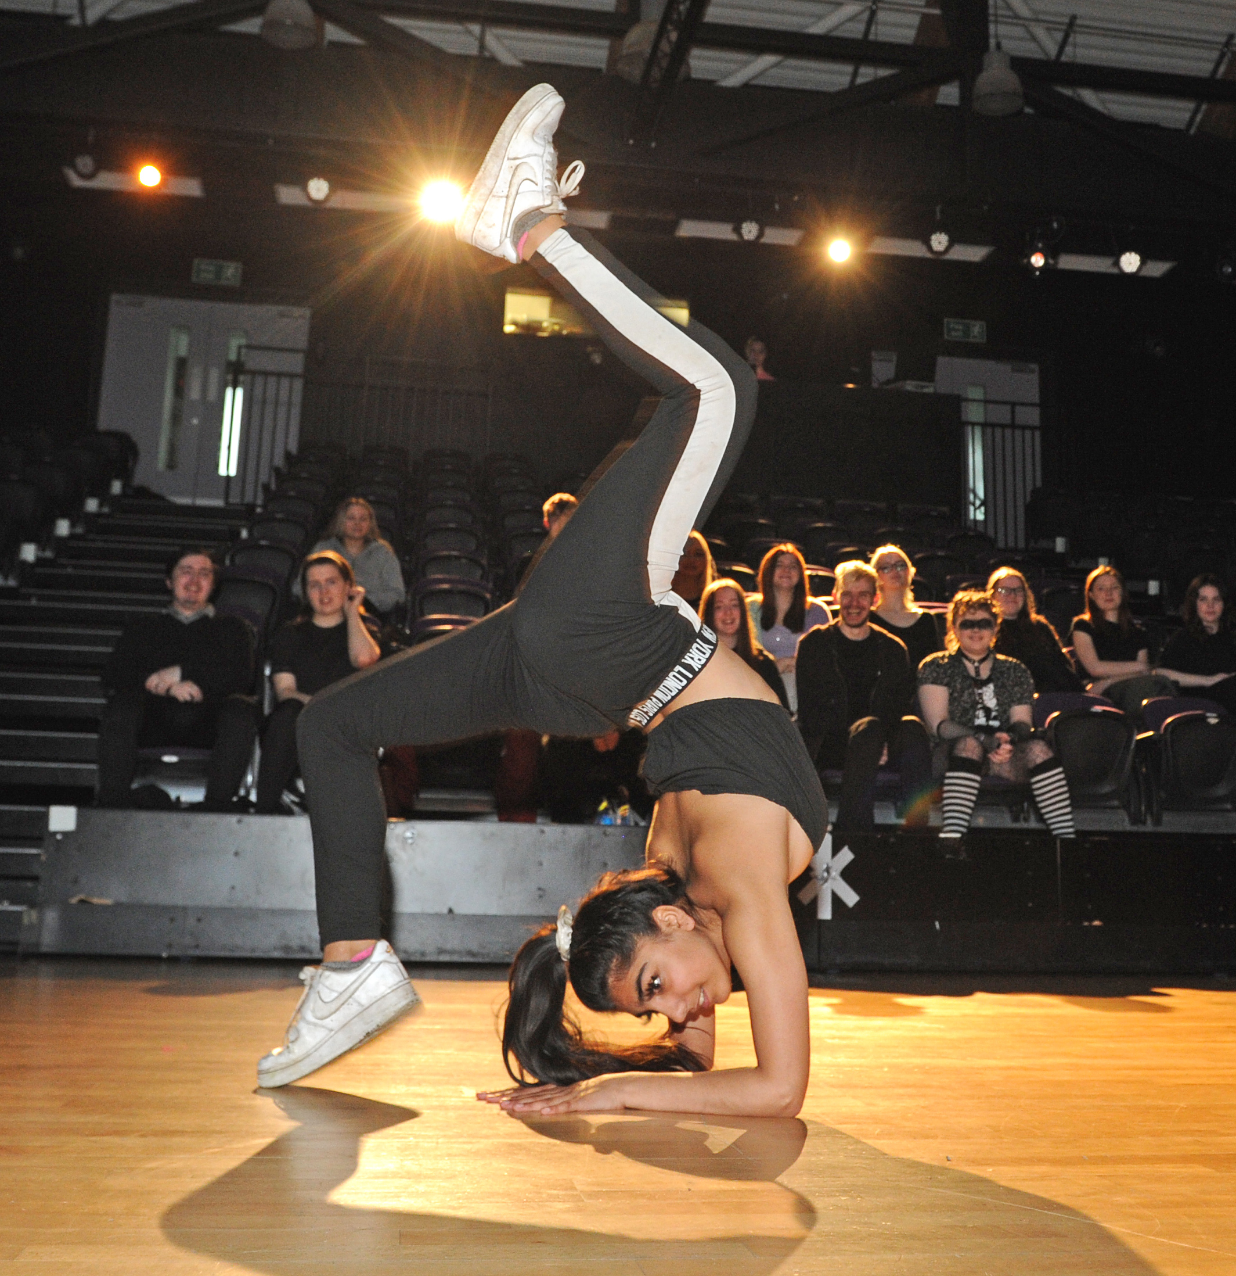

VOCATIONAL
COURSES
Applied Science
Art & Design
Beauty Therapy Bricklaying
Business
Carpentry & Joinery
Childcare
Computing & ICT
Creative & Digital Media
Electrical Installation
Engineering
Games Design
Graphic Design
Hairdressing
Health & Social Care
Hospitality & Catering
Media Make-up
Motor Vehicle
Performing Arts (Acting/Dance)
Plumbing
Public Services
Sport
Travel & Tourism
Vocational Studies

Slide 5


MYTH BUSTING
X
“Vocational qualifications are for people who don’t do well at school”
Vocational courses are chosen for learning style and career goals, not academic ability
X
“Vocational qualifications aren’t as good as A Levels”
Level 3 vocational qualifications are equivalent to A Levels. Distinction* is equal to A* at A Level. Remember vocational courses are not the ‘easy’ option.
X
“I cannot apply to university with a vocational qualification”
False! A quarter of university students studied a BTEC rather than A Levels

Slide 6
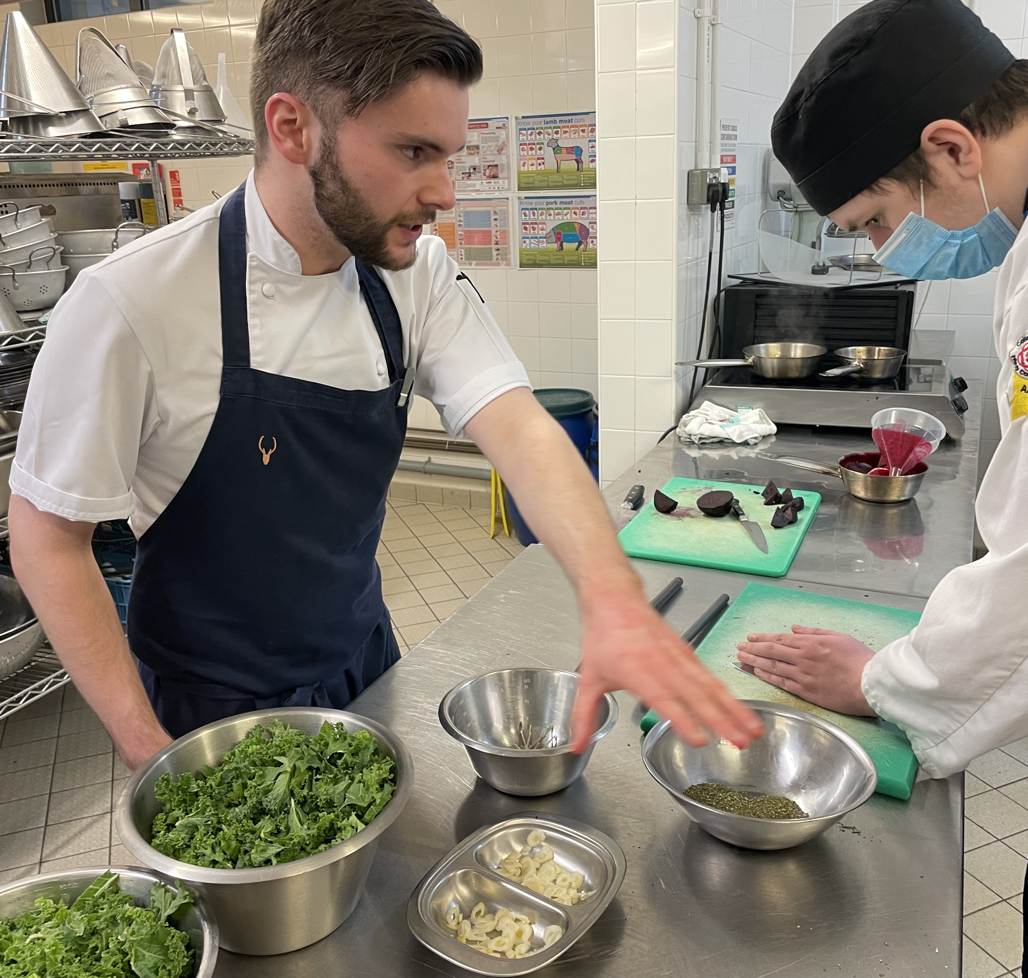

HOSPITALITY & CATERING
Why study Hospitality & Catering?
Gain some fantastic skills for life
Excellent career prospects- chefs are hugely in demand!
You will learn in an industry-standard kitchen and an award winning restaurant
Workshops with professional chefs
Serve real customers and build your confidence
You could travel the world working in hotels, on cruise ships or the best restaurants

Slide 7
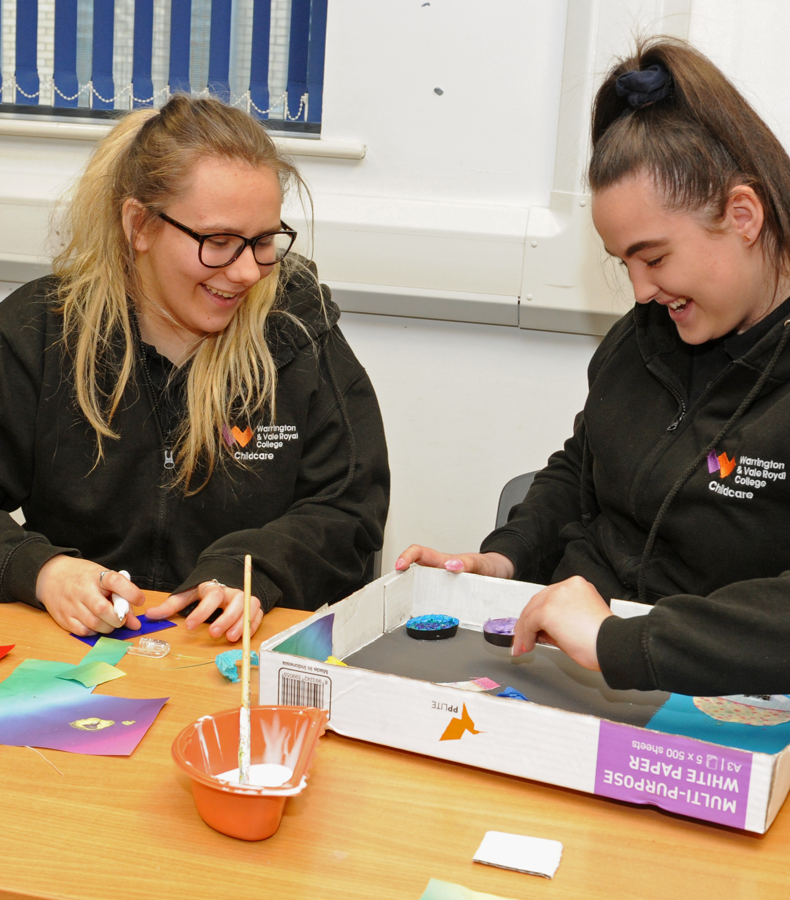

CHILDCARE
Why study Childcare?
Learn from professionals who have worked in the industry for many years
Lots of placements and work experience- nurseries, primary schools, day centres
Rewarding career
Get to use your creativity
There is always a demand for Childcare professionals- job security
Lots of progression opportunities

Slide 8
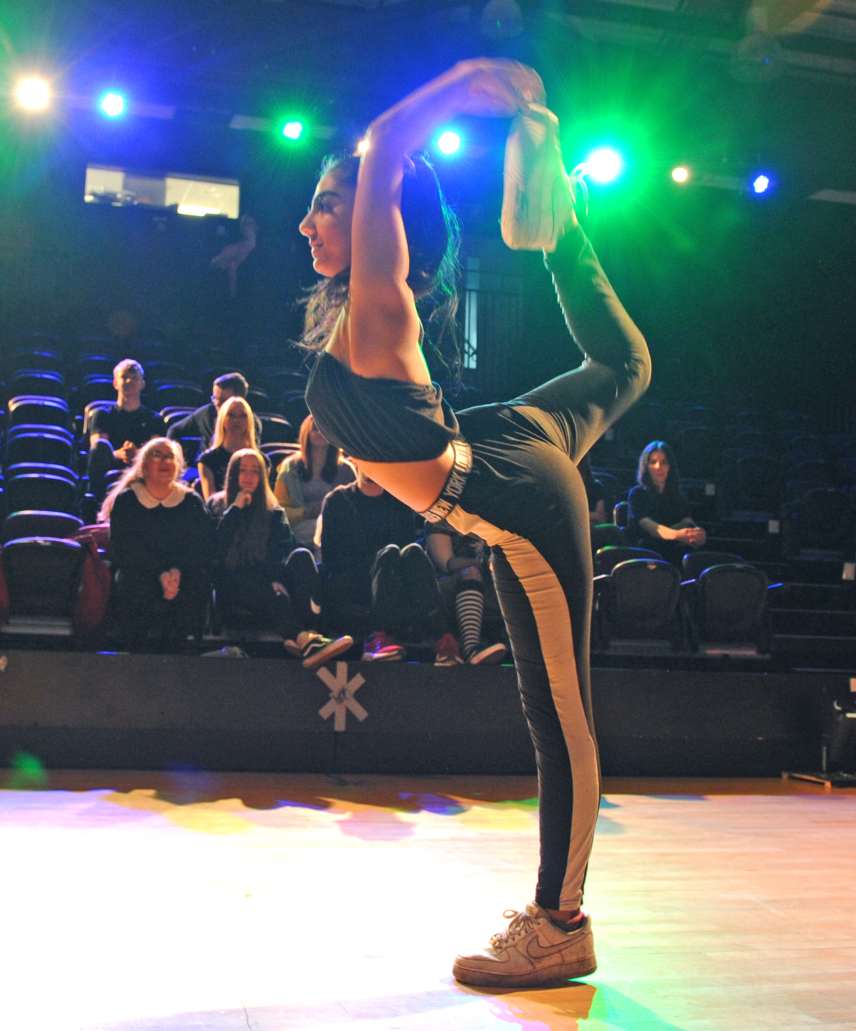
PERFORMING ARTS
Why study Performing Arts?
Dance/Acting pathway
Talented tutors with industry experience
Take part in four performances each year
Learn in our specialist theatre and dance studios
Exciting trips to local theatres and the West End
Lots of future options including actor, dancer, teacher, stage manager, theatre director, radio work.

Slide 9


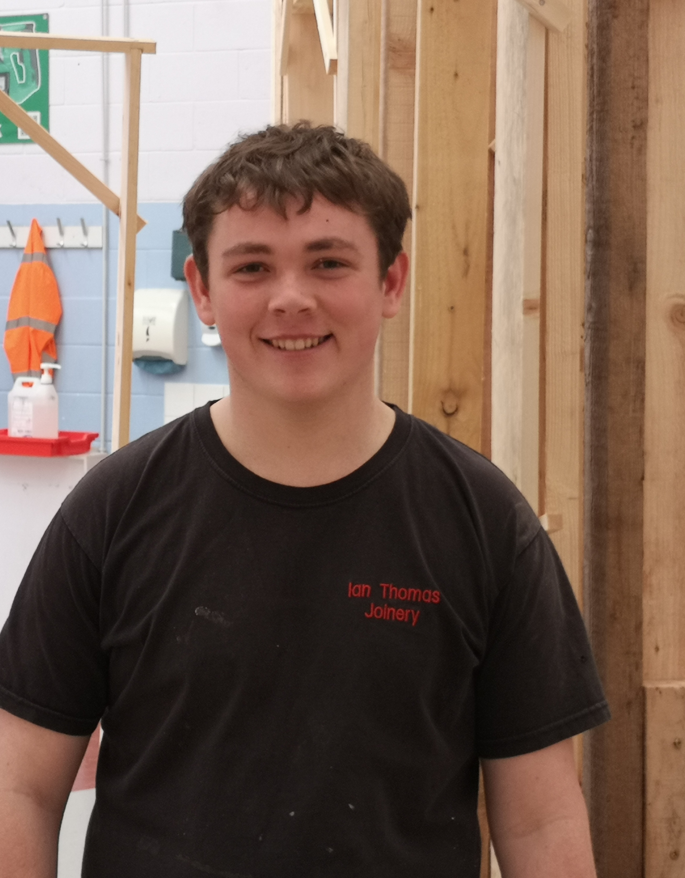
WHAT IS AN
APPRENTICESHIP?
Do you want to:
Achieve an internationally recognised professional qualification?
Gain hands-on valuable skills and experience?
Earn money whilst you learn?
Take your first step onto the career ladder?
An apprenticeship could be right for you!
With an apprenticeship you will develop your skills and knowledge with on-the-job training in your chosen area and by attending college once a week (may vary dependent on your apprenticeship).

Slide 10


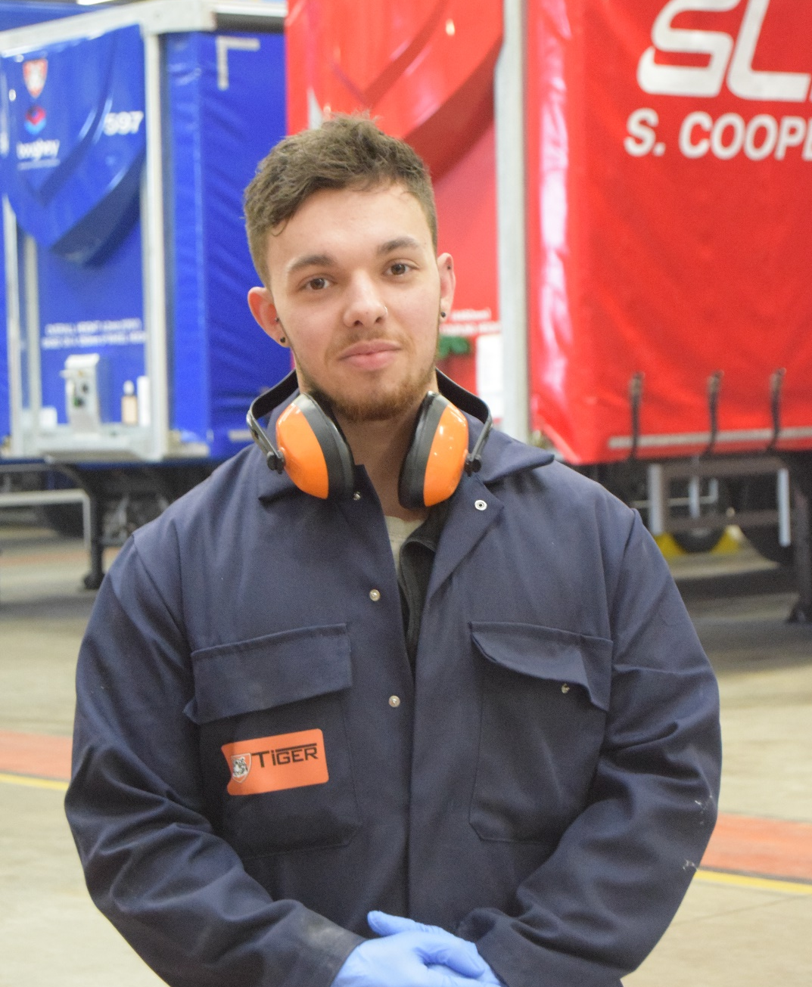
APPRENTICESHIPS
Accountancy
Bricklaying
Business Administration
Carpentry & Joinery
Customer Services
Electrical Installation
Engineering
Human Resources
IT Infrastructure
Laboratory Technician
Motor Vehicle
Plumbing
Team Leading/Supervisory
It’s a match! Did you know that we have our very own apprenticeship matching service?
apprenticeships@wvr.ac.uk

Slide 11

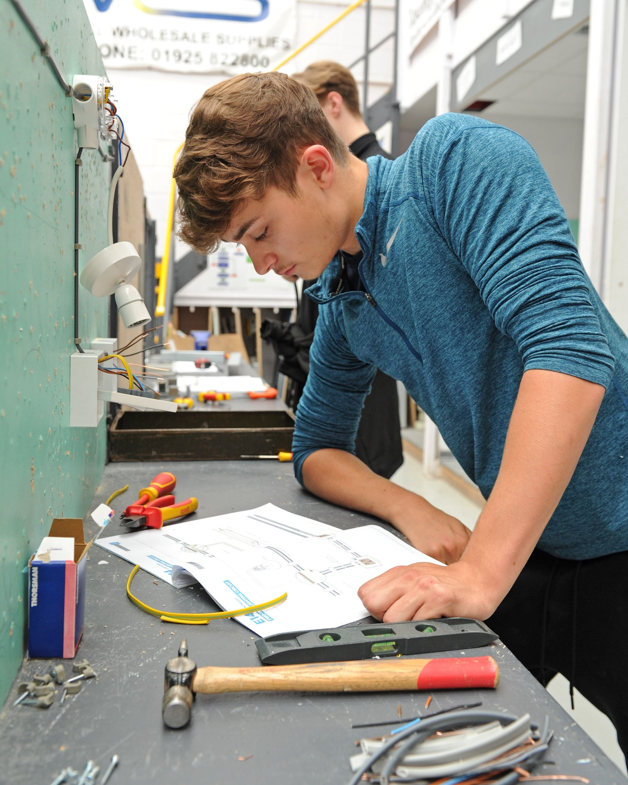

AIM HIGH
ENTRY REQUIREMENTS
Providing learning opportunities for all students, all levels.
We have a course to suit everyone!
ENTRY LEVEL | No minimum grades required. Everyday skills in reading and writing, basic literacy and numeracy skills and a willingness to learn.
LEVEL 1 | Minimum of 4 GCSEs at grade 2 or above.
LEVEL 2 | Minimum of 4 GCSEs at grade 3 or above, including maths and/or English, or successful completion of a level 1 course. If you have a GCSE grade 3 or lower in English and/or maths you will have to resit alongside your course.
LEVEL 3 | Minimum of 5 GCSEs at grade 4 or above, including maths and/or English, or successful completion of a level 2 course. If you have a GCSE grade 3 or lower in English and/or maths you will have to resit alongside your course.

Slide 12


YOU CAN RESIT
YOUR ENGLISH &
MATHS WITH US!
We encourage you to try and strive for grade 4s and above in your English and maths GCSEs.
However if you don’t manage to achieve 4s in your English/maths we can help you achieve it at college with the help of our specialist tutors.
Your timetable will include weekly sessions to study for your GCSE English/maths, alongside your main course.

Slide 13

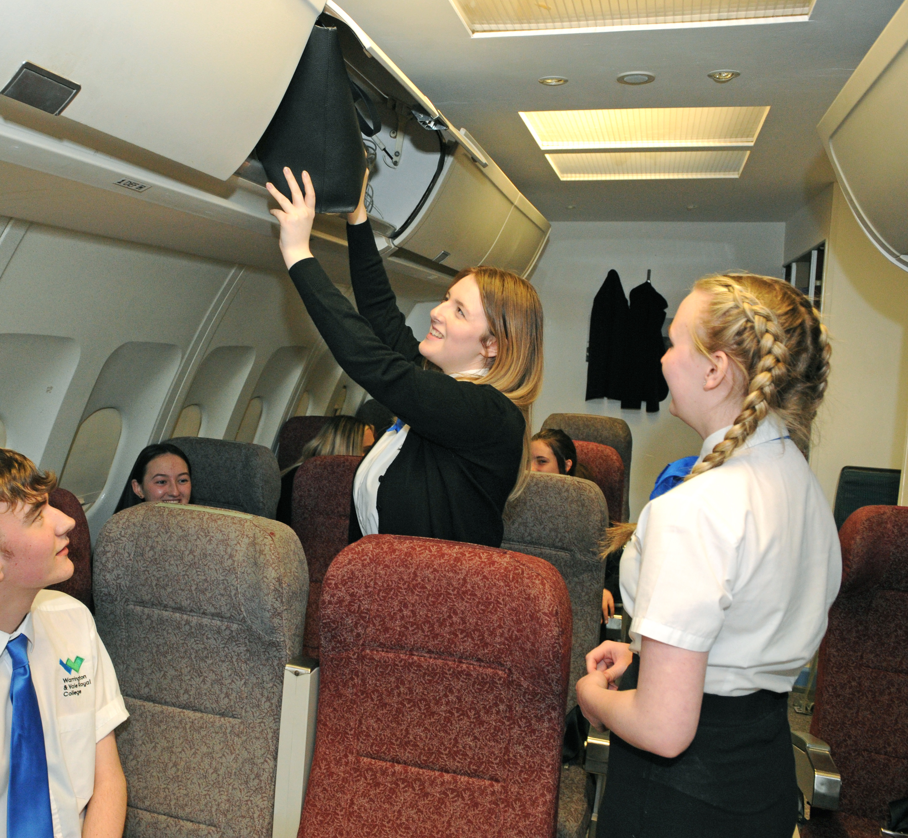

WHY CHOOSE US?
‘Good’ rating in our latest Ofsted inspection
(October 2019)
Outstanding results! Almost a third of our Level 3 students achieved Triple Distinction Star- equivalent to 3 A* grades at A Level.
Record number of Level 3 students progressing to their first choice university.
Thousands of students choose us each year, due to our strong and varied links with employers.
98% of students are happy on their course, and 99% say their tutors know their subjects well.

Slide 14
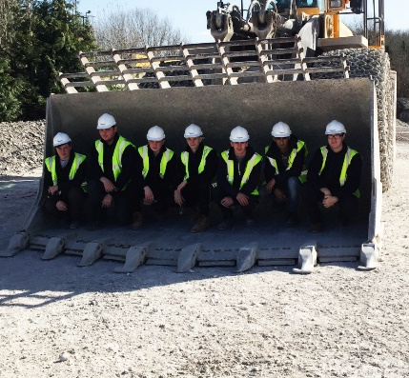
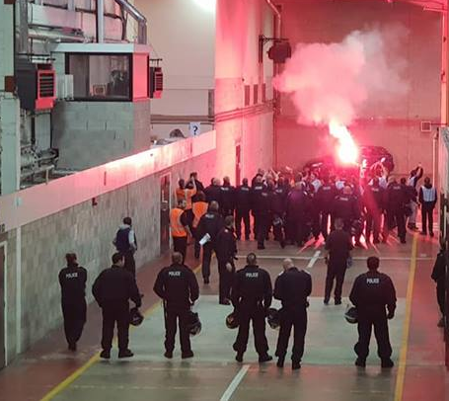
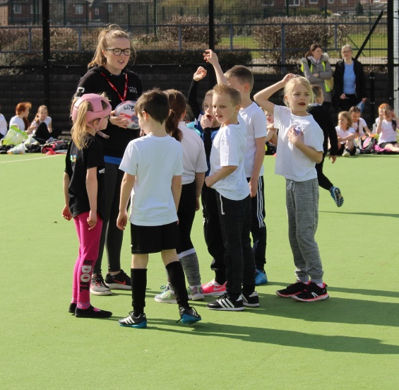
WORK PLACEMENT
EMPLOYER LINKS
You’ll be given the opportunity to work alongside high-profile employers, gaining valuable hands on experience.
We benefit from working with some high-profile employers including the NHS, Redrow Homes, Cheshire Police and Warrington Wolves.

Slide 15

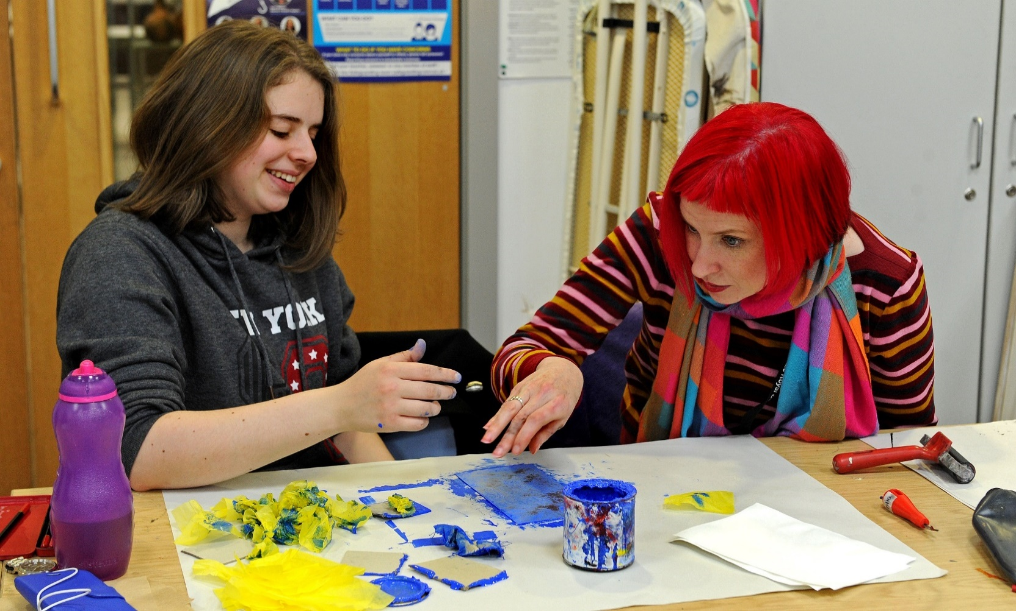
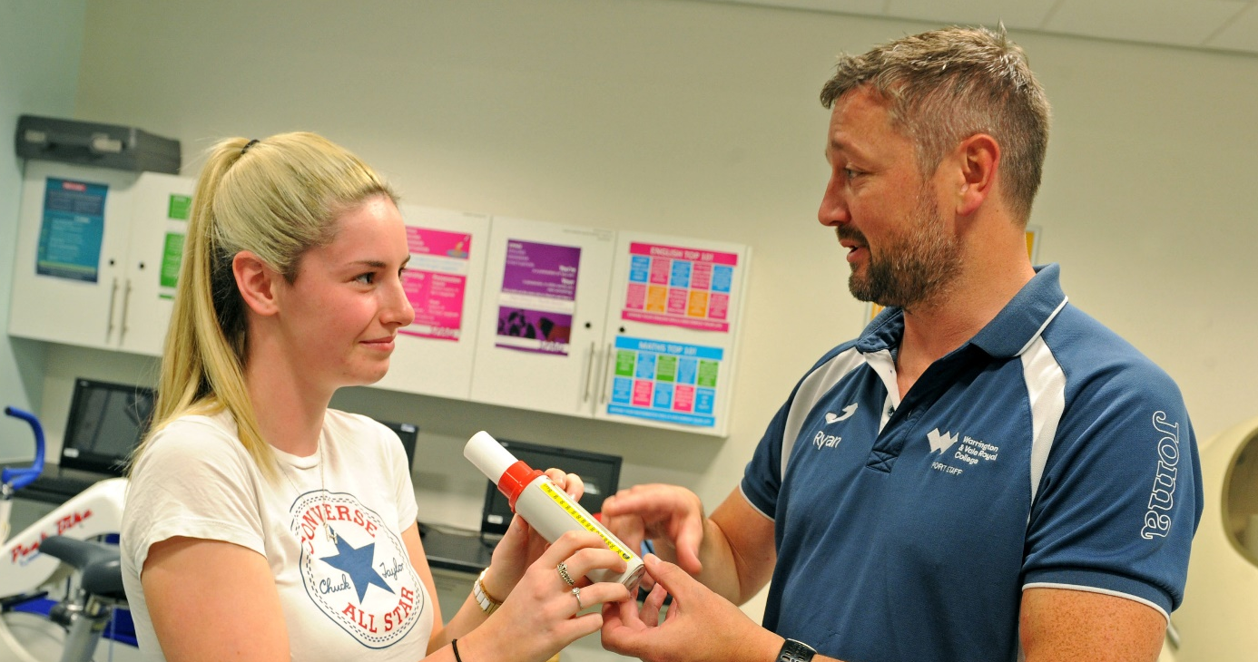
INDUSTRY
EXPERIENCED TUTORS
Our experienced tutors are industry experts and are passionate about their subject, bringing a wealth of current skills and knowledge to their teaching. Art tutor Hazel is a practising artist in her spare time!
ONE-TO-ONE
SUPPORT
Our students comes first. You will be allocated a Progress Coach and 1:1 support who will support you during your time at college.

Slide 16

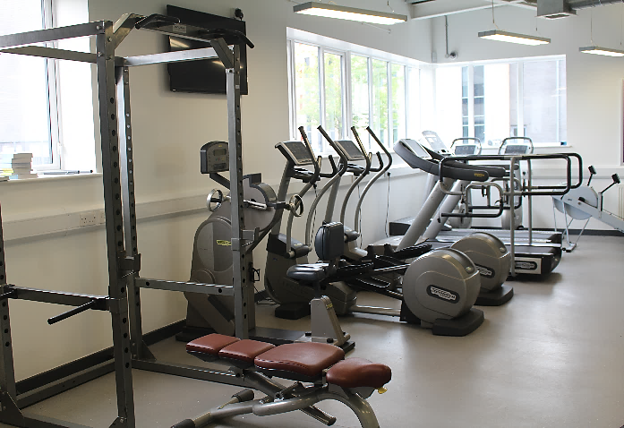
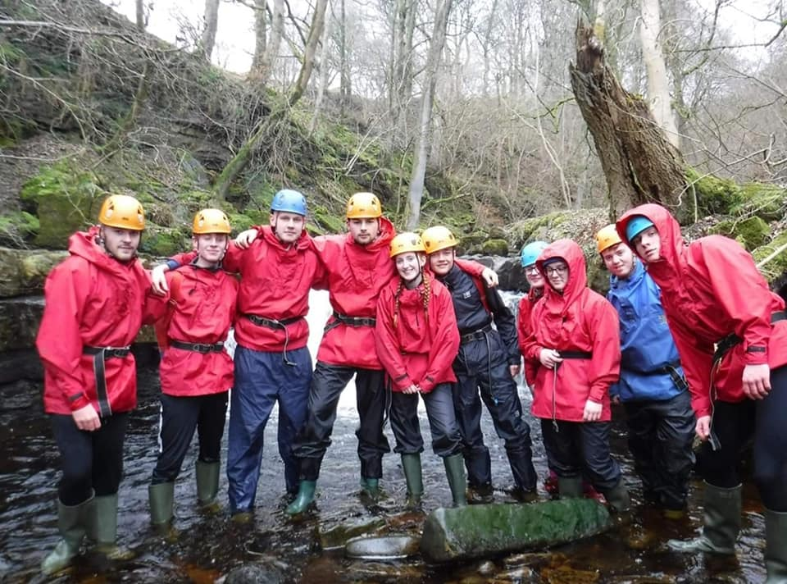
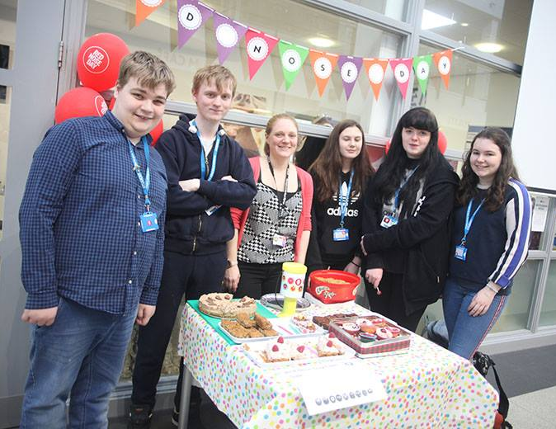
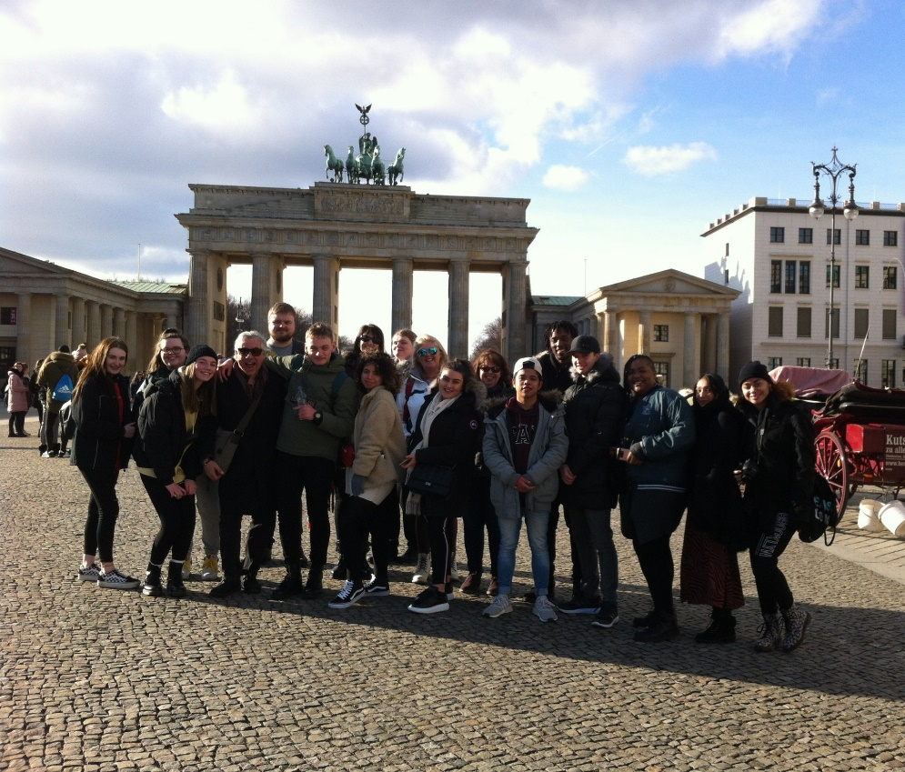
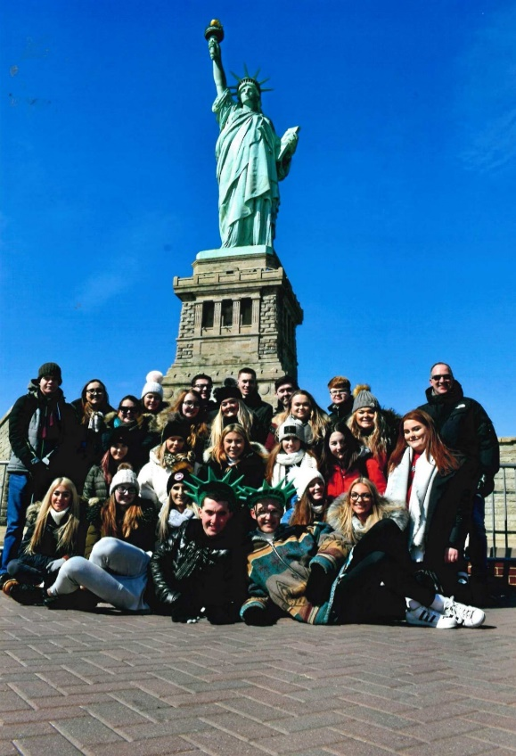

THE FUN STUFF!
It’s not all work and no play!
There’s always an event or trip you can get involved with!
Enrichment
Trips & Travel
Student Council
Sports & Recreation
Themed Events
Clubs & Societies

Slide 17

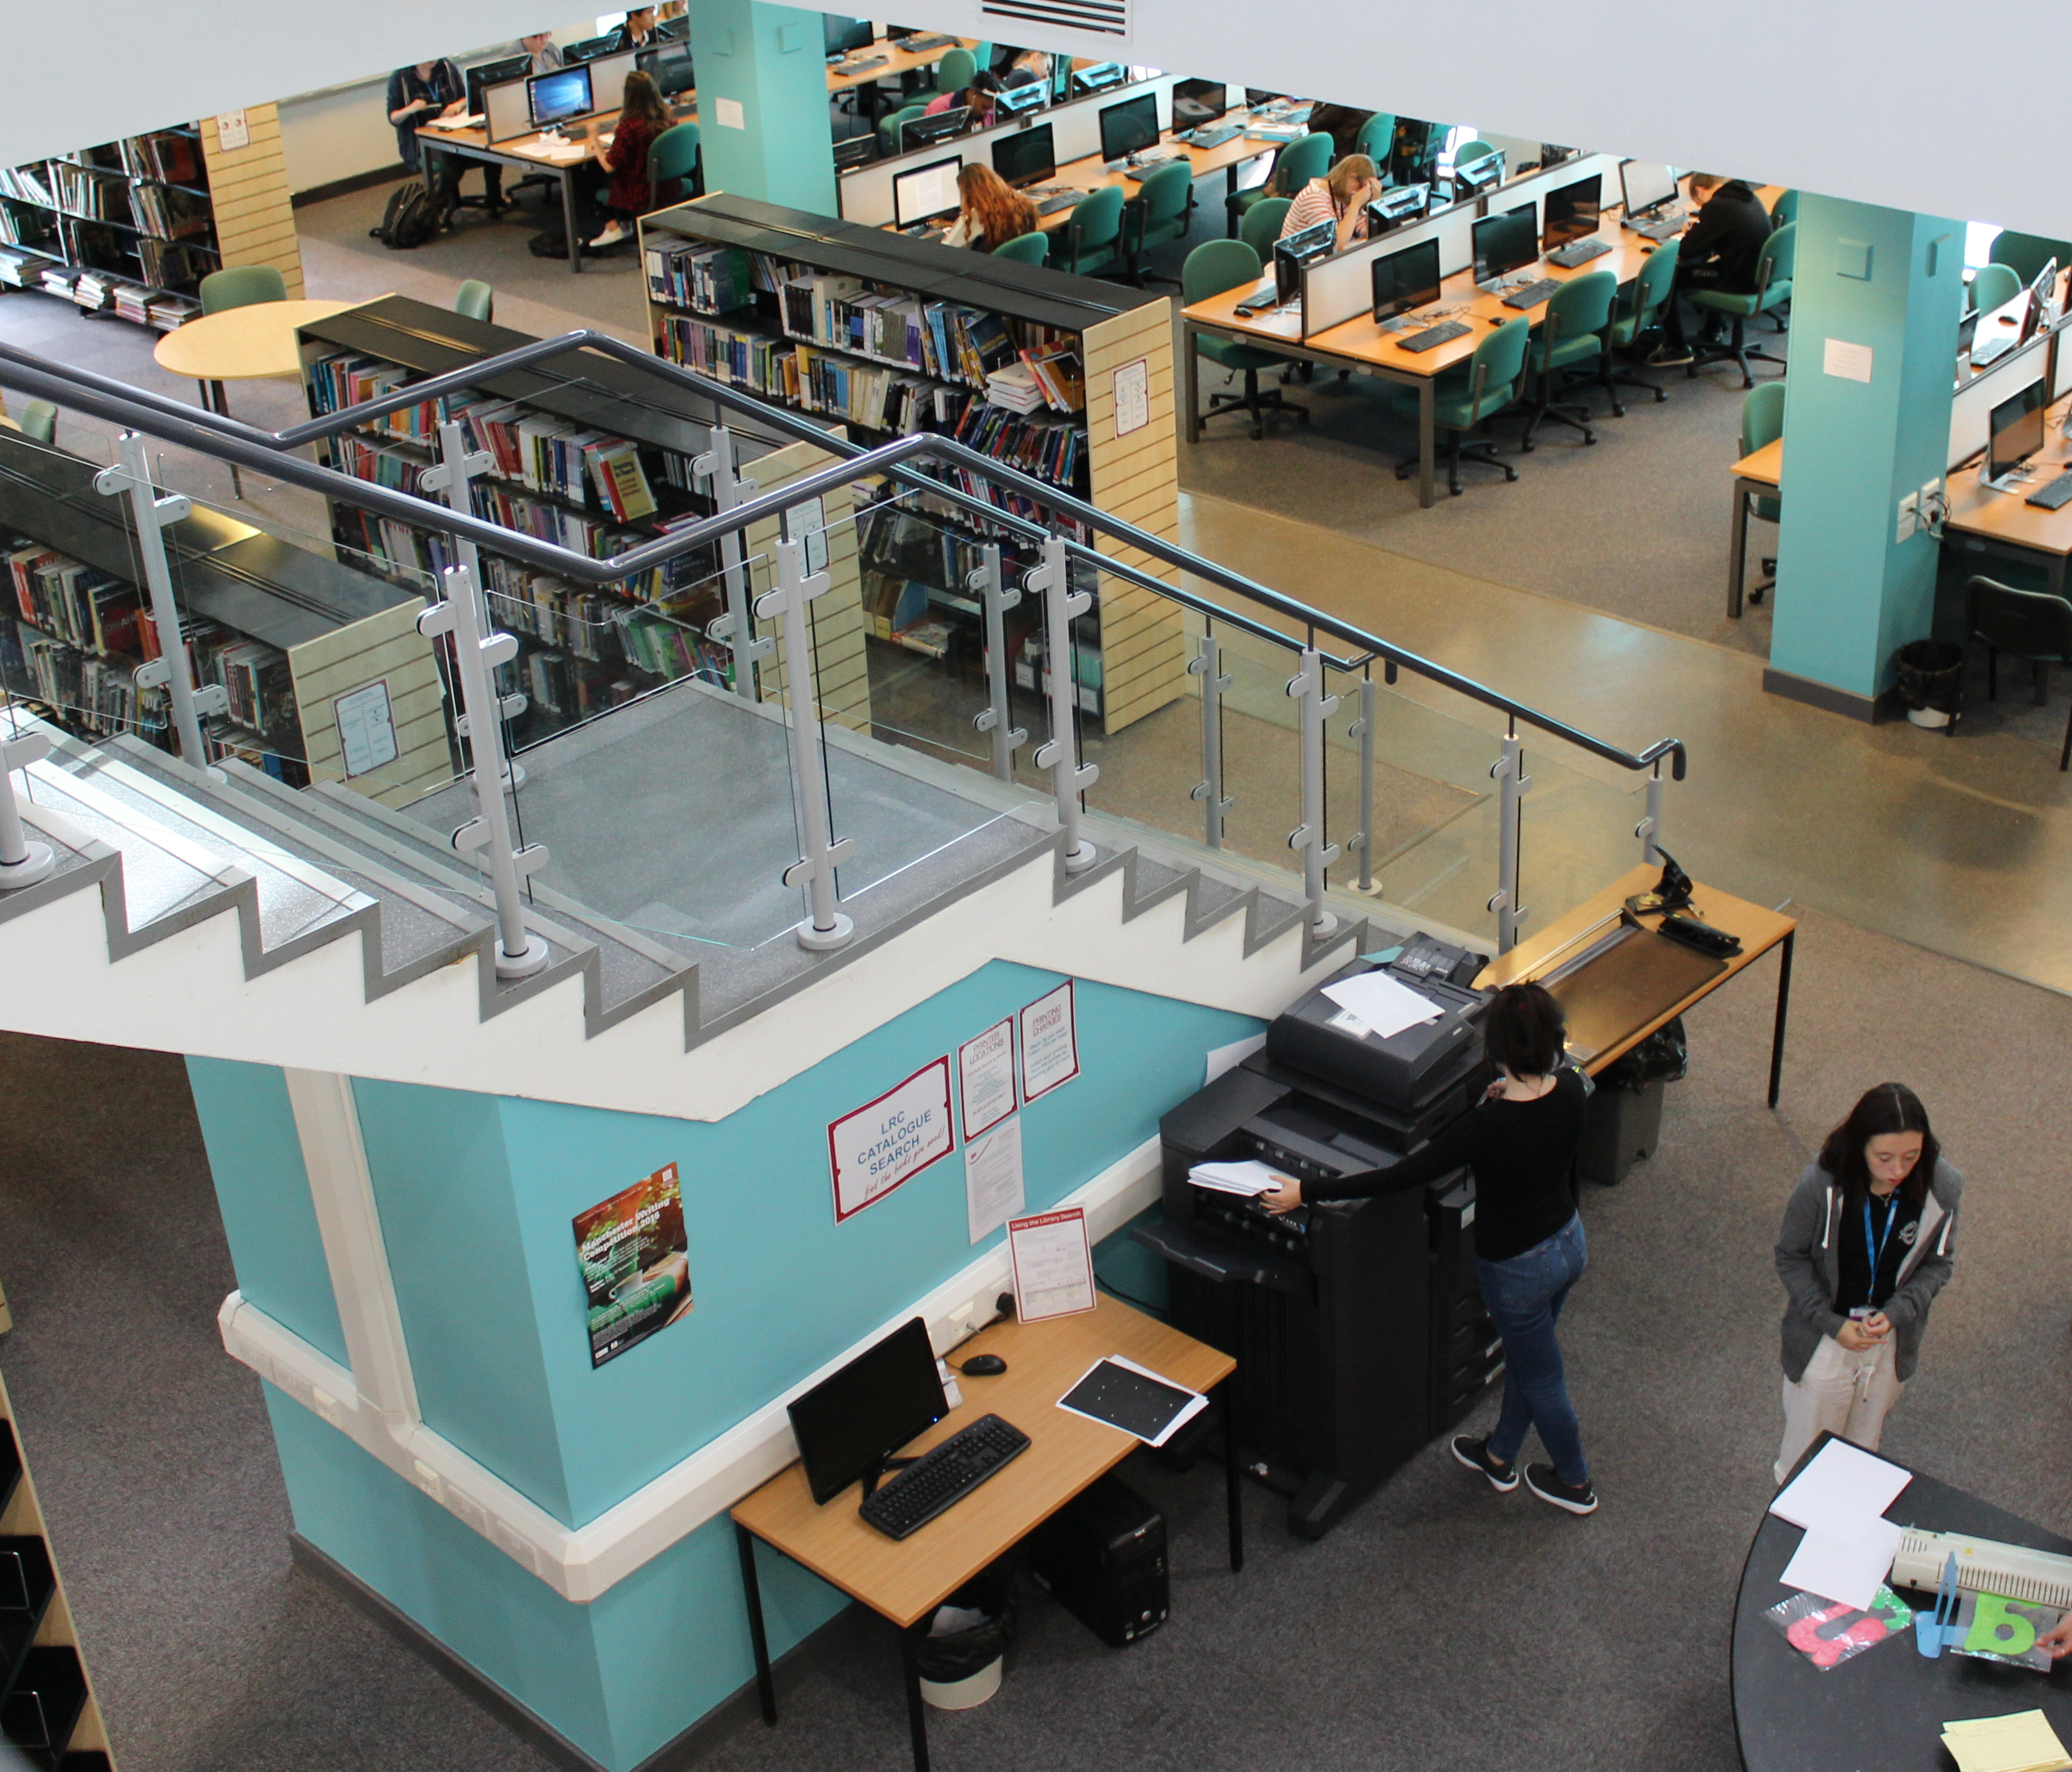
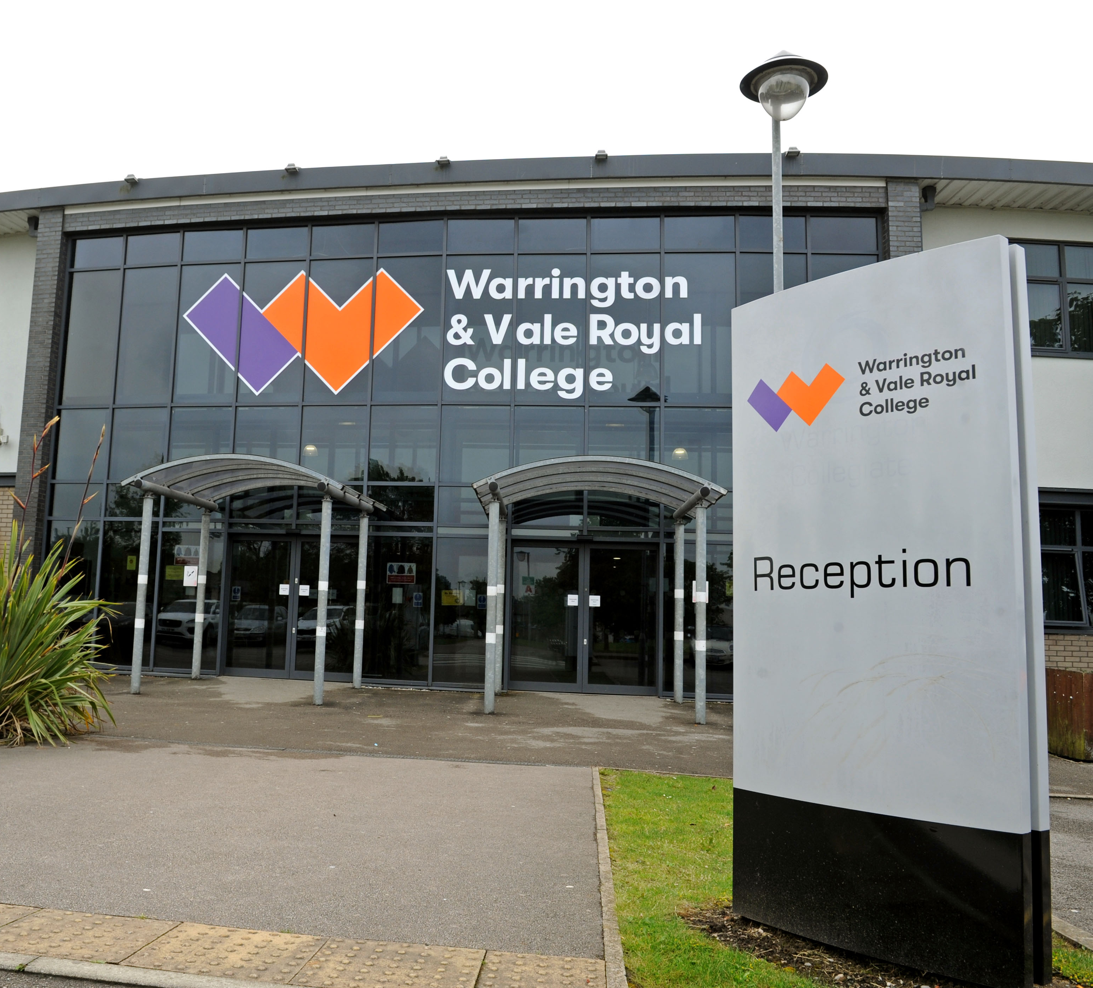
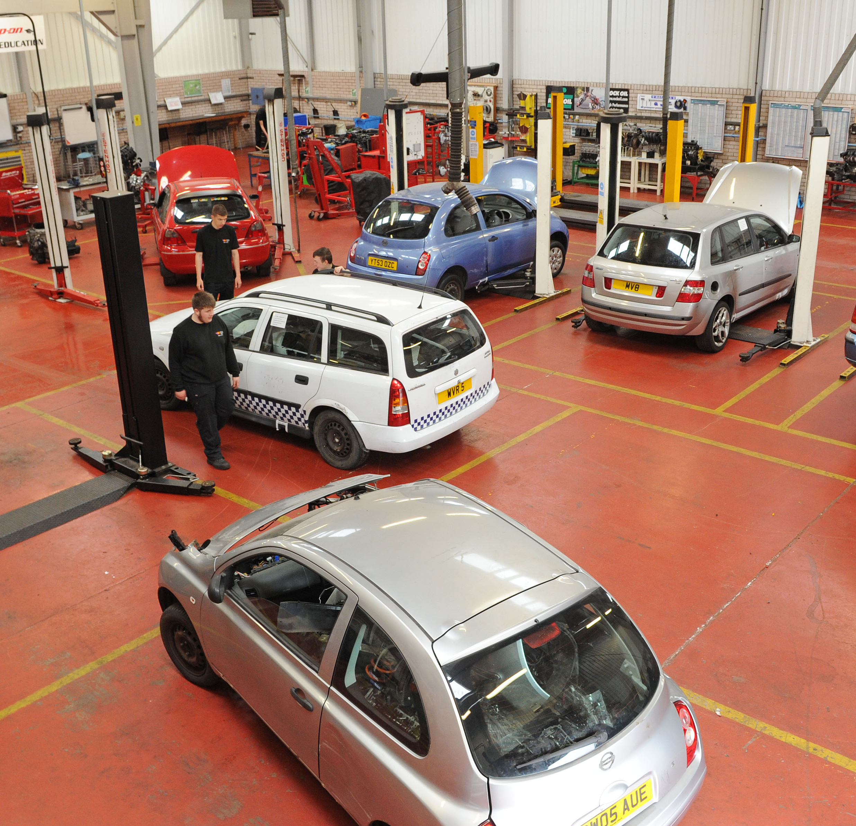
WARRINGTON CAMPUS
Our Warrington campus has a university feel and houses industry standard facilities, including modern commercial hair and beauty salons, state-of-the-art construction and engineering workshops, a brand new sports facility, a fully fitted mechanics garage, an award-winning restaurant and an impressive 160 seat theatre.

Slide 18
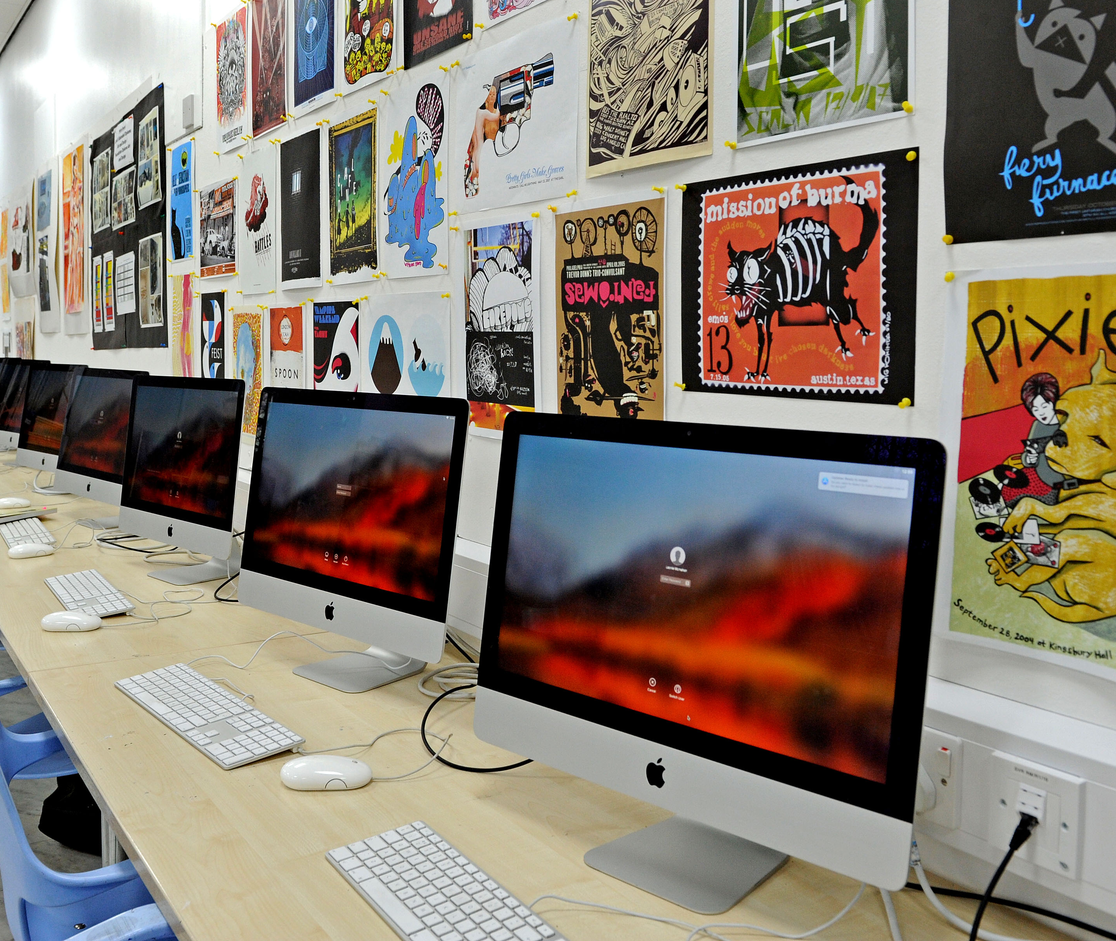
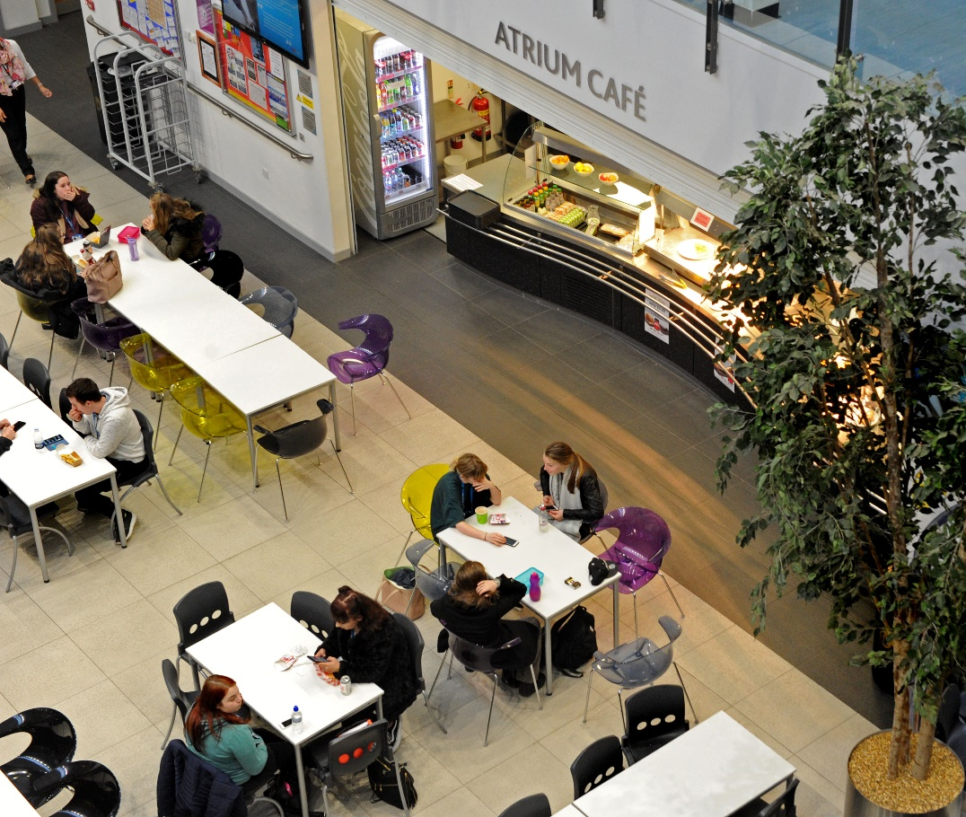

WINSFORD CAMPUS
Our modern Winsford campus has a relaxed, friendly sixth form atmosphere and is located within walking distance of Winsford town centre. It boasts purpose-built specialist workshops, a sociable atrium area and a dedicated Learning Resource Centre.

Slide 19

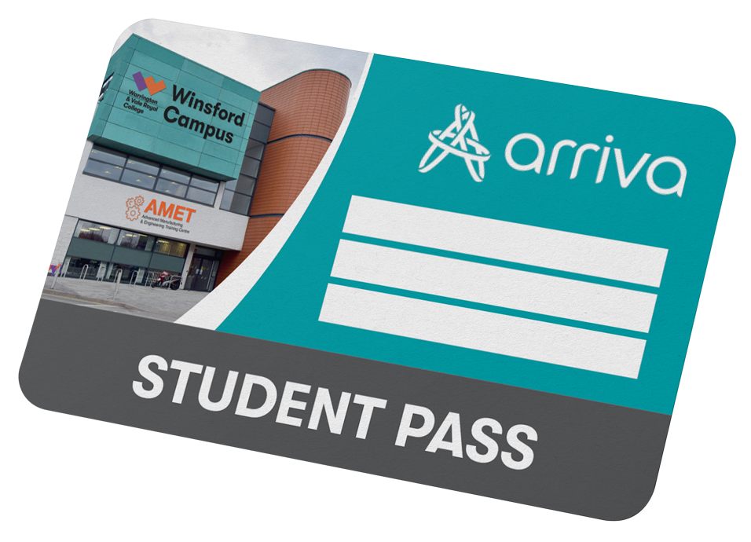
GETTING TO COLLEGE
TRAVELLING TO COLLEGE COULDN’T BE EASIER!
Our Warrington and Winsford campuses are well connected and serviced by excellent transport links.
FREE Arriva bus pass! For all students studying at Winsford campus who live more than 1 mile away
WINSFORD CAMPUS
WARRINGTON CAMPUS
FREE shuttle bus to Warrington campus via Winsford, Hartford and Northwich
Register at wvr.ac.uk/bus
*Arriva bus pass valid during term time only.

Slide 20


FREE
BREAKFAST!
All our 16-18 year old students
receive a FREE breakfast, upon
arrival at the college.
What a great way to start your day!

Slide 21


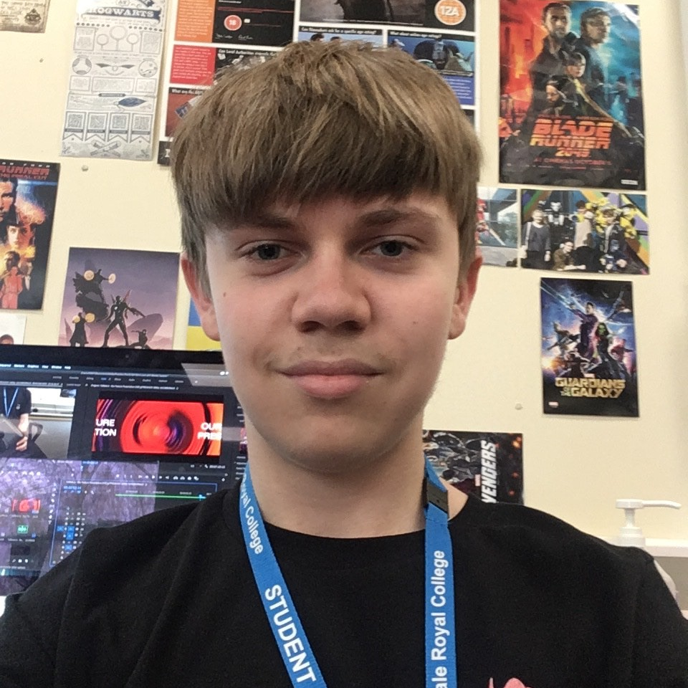
MY STORY…
Student: Morgan Mackerness
Course: Level 3 Creative & Digital Media
School: Weaverham High School
Morgan loves the creativity of his course and intends to progress onto the college’s HNC in Creative Media Production, before attending a dedicated film school.
“The creative freedom the tutors allow you to have while creating your projects is great- they always listen to your ideas for your films and give you helpful advice.”

Slide 22


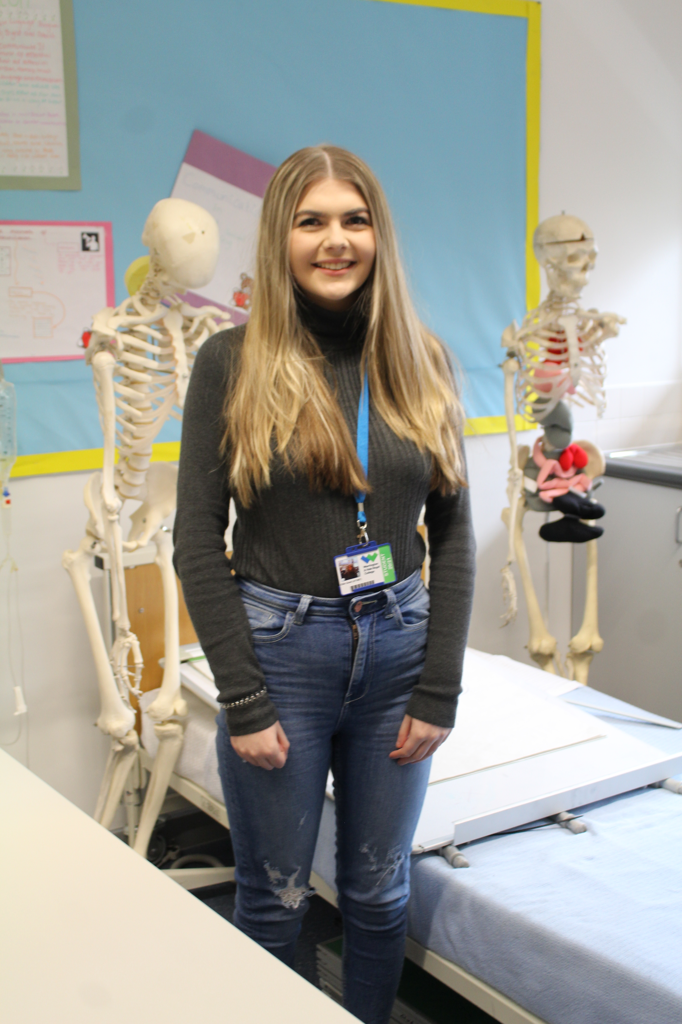
THANK YOU
FOR WATCHING!

