Slide 1

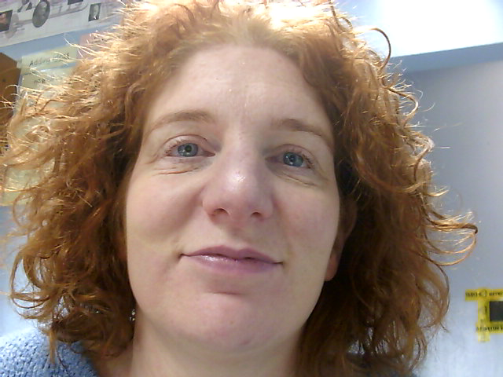
MUSIC
Year 9 Options

Slide 2

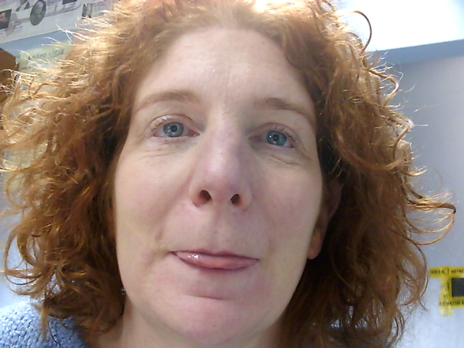
Why Music?
Do you enjoy playing / singing music?
Do you like learning about different styles of music?
Are you making good progress with your music in year 9 (in and out of the classroom)?
If you answered YES to these questions then Music GCSE is for you….

Slide 3
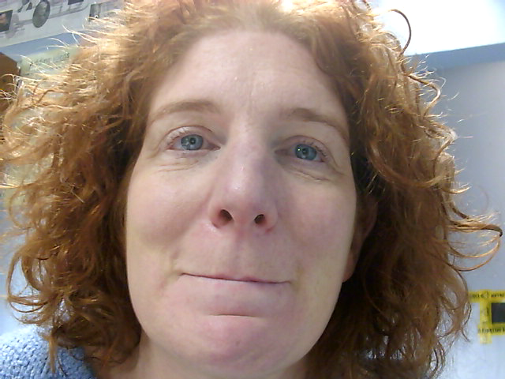
Why Music?
Music is one of the few subjects left that still has a 60% practical element to it
Studying a creative subject such as music stimulates the brain and improves verbal memory and literacy skills along with Mental Health

Slide 4

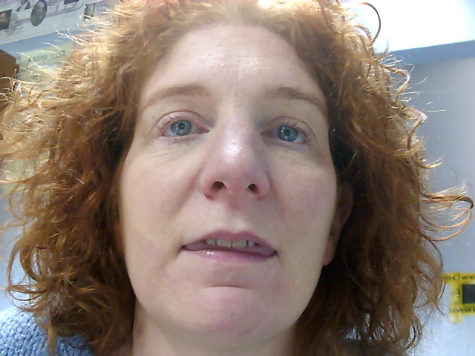
Examination details
We follow the AQA syllabus and over the 2 years you will:
Perform 2 pieces (1 Solo & 1 Ensemble) (30%)
Create 2 compositions, using “musescore” on
computers (30%)
Sit a listening examination (40%)

Slide 5
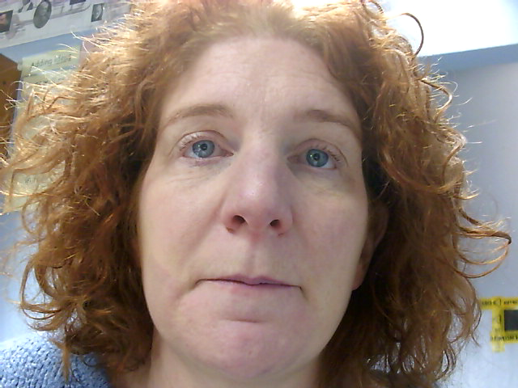
Course content:
This really varies on the course and you can choose your own style for the coursework element.
During lessons we will prepare you for the listening exam through:
Classical Music World Music
Film & Games Music Pop Music

Slide 6
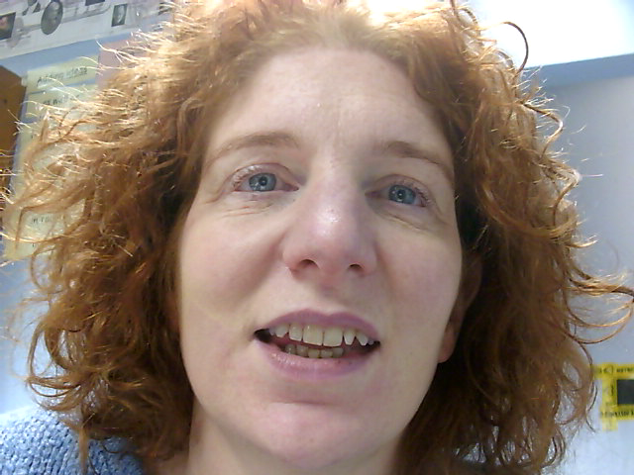
What current GCSE pupils think:
“It’s really good to have a creative subject when the rest of my timetable is filled with really academic stuff where I have to write all lesson”
“I think it’s really important for college and work in the future that you’re not someone that has spent all their school life studying for tests, you need to be more of an all-rounder
“In my college interviews and applications I have realised how lucky I am to have something like music on my CV rather than just the same subjects that everyone else has studied. It makes me stand out from the crowd in interviews which is great because the courses I want to do are really over-subscribed”

Slide 7
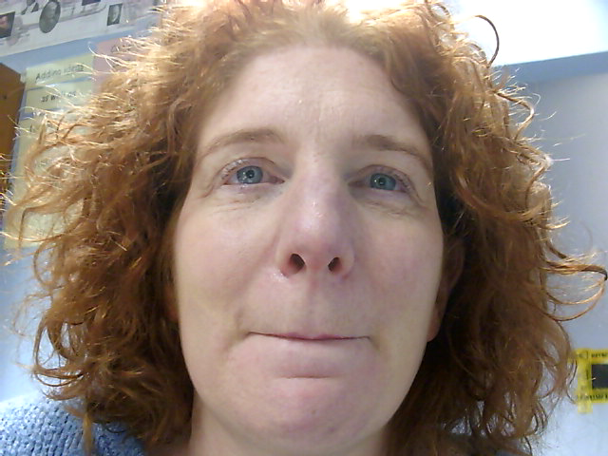
Common misconception
“There’s no point in me taking music as a GCSE as I know I don’t want to be a musician when I’m older”…
Do you think that in your future, you might have to do the following:
Present an idea confidently to a group of people?
Organise a group to prepare a piece of work ready for a strict deadline?
Create something new and different that stands out from others’ work?
Think on your feet when something goes wrong during a presentation?
MUSIC GCSE could help with all the above

