Slide 1
Hospitality & Catering

Slide 2


Hospitality is the third largest private sector employer in the UK
Hospitality and catering is a dynamic, vibrant and innovative sector, delivering vital jobs, growth and investment in the heart of our local communities
WJEC Level 1 / 2 Vocational Award in Hospitably and Catering
Unit 1: The hospitality and catering industry
Written exam – 1 hour 20 minutes, 40% of the qualification
Unit 2: Hospitality and catering in action
  Assignment brief will be provided with a scenario and several tasks to complete. Controlled assessment over 12 hours, 60% of qualification. Pupils will analyse, plan, prepare and evaluate

Slide 3


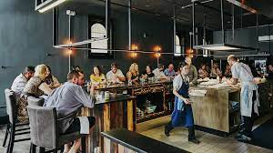
Hospitality and Catering Award – Unit 1 Exam
In this qualification you will learn about :
The different hospitality and catering providers. For example, restaurants, cafes, takeaways, hotels, fast food outlets
Working in the hospitality and catering industry, employment roles, types of employment contracts
How the provision works and the factors affecting the success of the industry, for example environmental factors, technology and media types
Customer needs
Health & safety and food safety in hospitality and catering

Slide 4
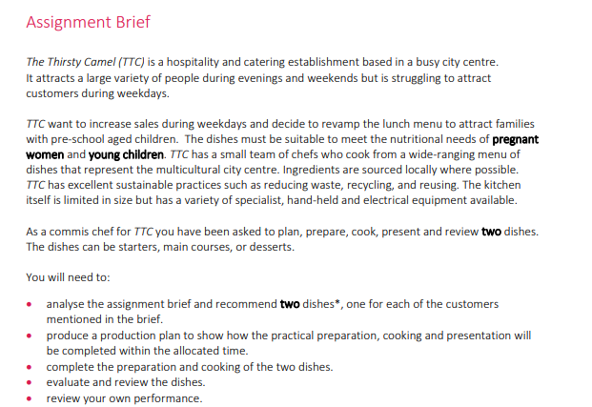










Unit 2 controlled assessment

Slide 5
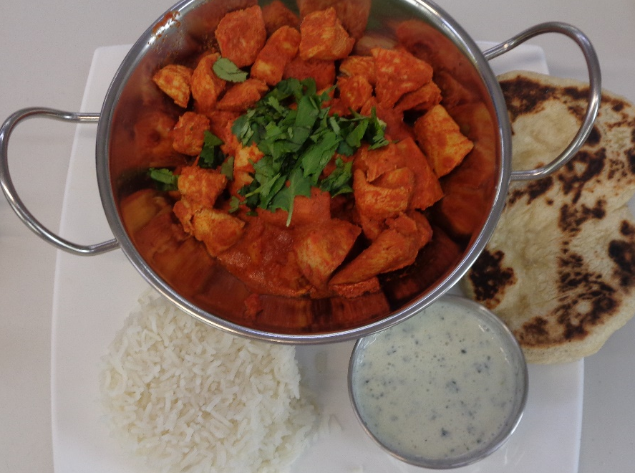
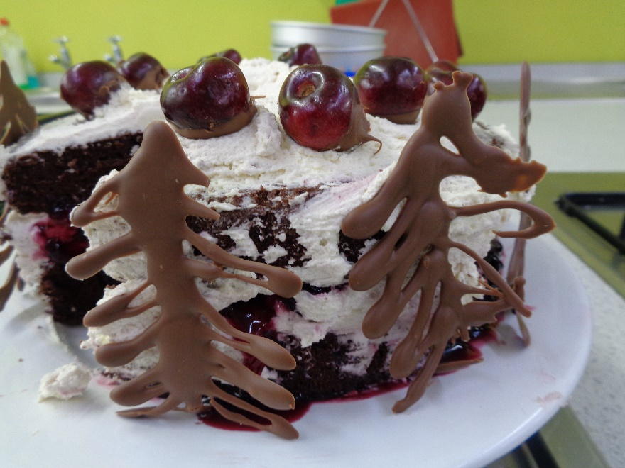
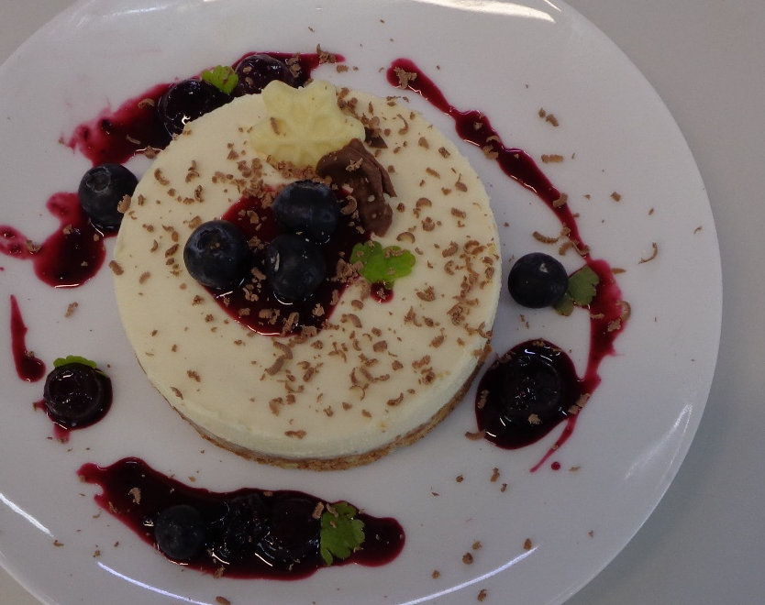
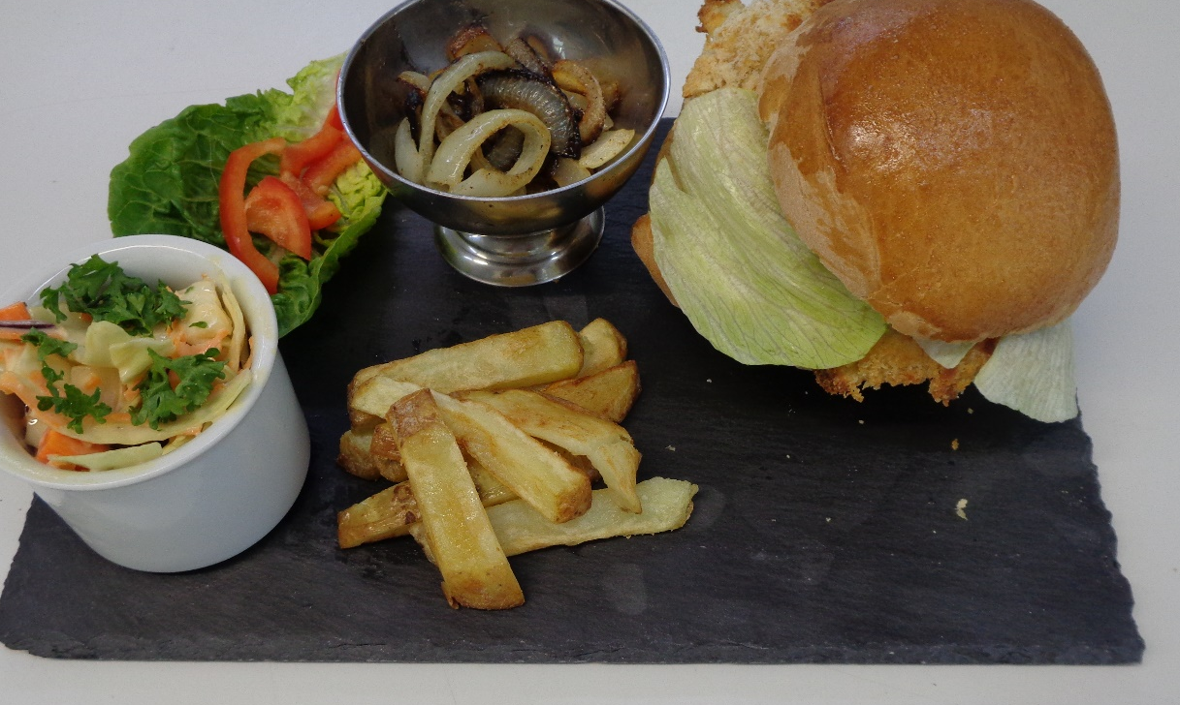
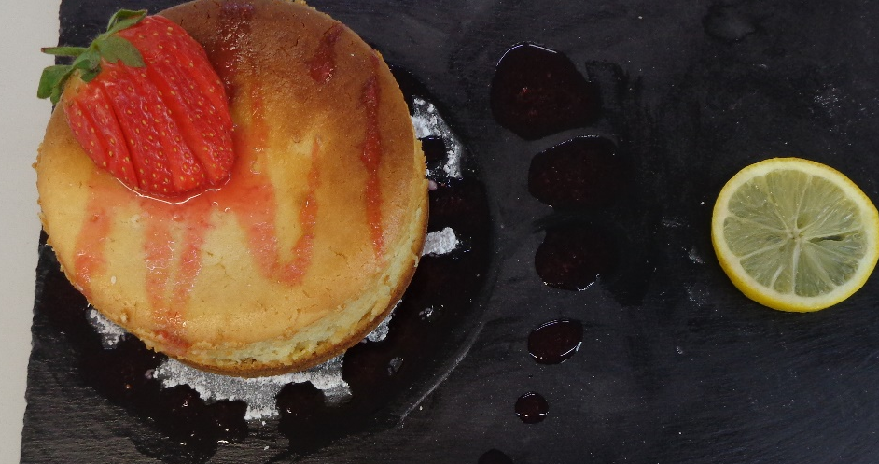
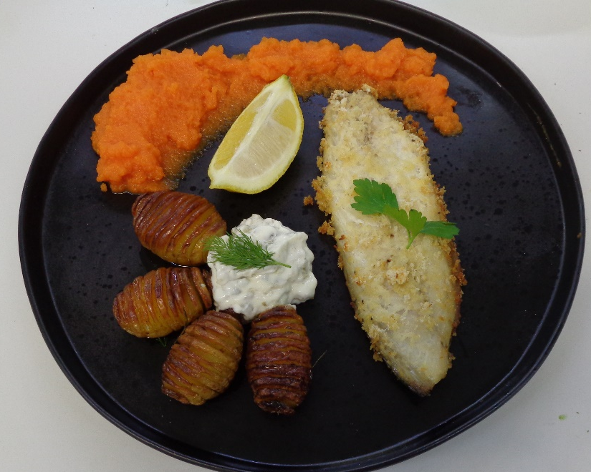
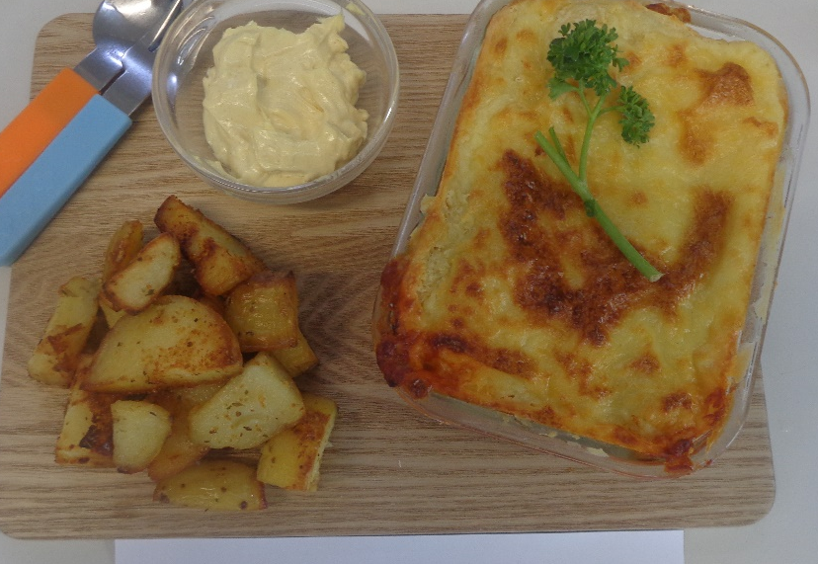
Example dishes…

Slide 6
WJEC Level 1 / 2 Vocational Award in Hospitably and Catering – grading of the course compared to GCSE grades
H&C | GCSE equivalent grade
L2D* | 9 / 8
L2D | 7 / 8
L2M | 5 / 6
L2P | 4
L1D | 3
L1M | 2
L1P | 1

Slide 7
Transferable Skills
You will develop a range of skills which are attractive to employees, colleges and universities including
Communication
Confidence
Learning independently
Organisation
Problem solving
Time management
research

Slide 8

Potential careers…………
  Chef/cook
  Army/Navy Chef
  Environmental Health Officer
  Food Scientist
  Dietician / Nutritionist
  Food engineer
  Baker
  Food Writer
  Product developer
  Food stylist/photographer
  Food buyer
  Food lecturer (university/college)
Progression routes
Level 3 Food Technology
Level 2/3 in advanced professional cookery
Level 3 patisserie and confectionary
……….and perhaps onto university to study BA (Hons) Hospitality Management

